Slide 1
AI Task Assignment in Translation
Team 1
Rafel Servent Vastenavond
Stanislav Bulatskii
Gerzon Diaz Marcani
Hermes Barreiro Pena
Biel Bellavista Sola
Icons by Freepik from www.flaticon.com
Notes:
Hello, we're: Rafel, Stas, Gerzon, Hermes, and Biel.
And we’ll show you our proposal for a system that might be what you're looking for.

Slide 2
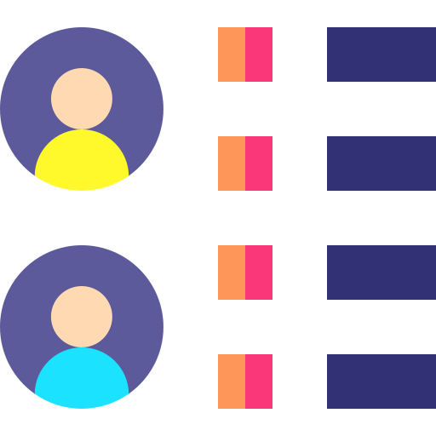


Notes:
Overview of the Expected final product
The system we plan on implementing will give a list of tanslator recomendations for every given task.
It will do this through various means, first, a rules based assesment will give a list of all translators that can perform each task with the given requirements. We will see this more in depth in a moment.
Then using machine learning we'll get a recommendation based on the data you’ve provided.
With this 2-step process, we aim to first show all viable translators and then use machine intelligence to handpick the best for the job.

Slide 3
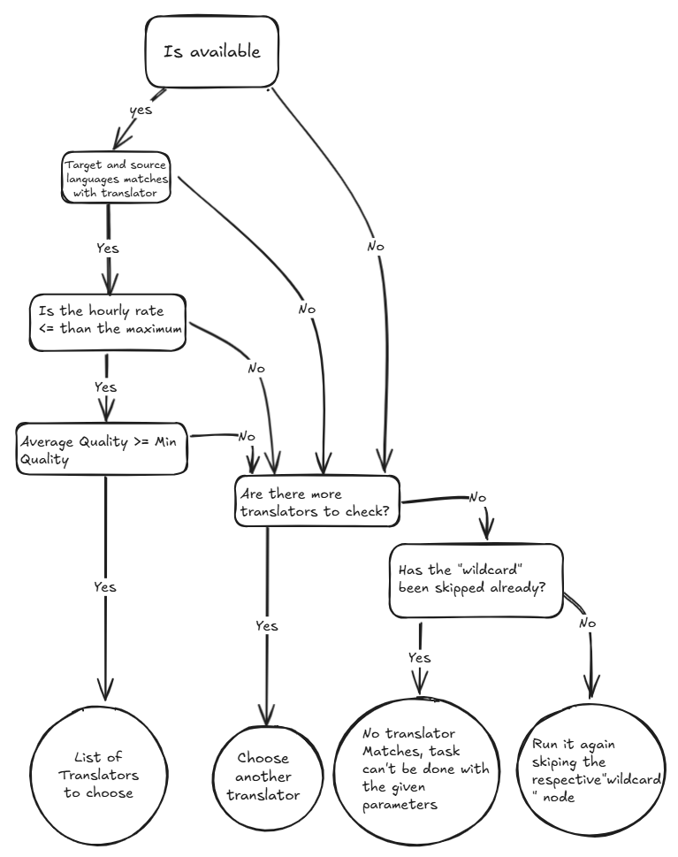
Notes:
FlowChart/Tree Explination
This graph shows a high level overview of what our base system will do to decide which translators to recomend.
First, we check if the translator's busy.
If they're free, we then check if both the source and target languages match.
We then check if their hourly rate is compatible with the clients maximum.
Finally, that translator and all other ones that match our criteria are grouped and put on a list of translators "Valid for the task".
If at any step the translator doesn't match the criteria, we look to see if we've checked all other translators.
When we haven't, simply keep going.
However, if we have checked all translators and none match, we run the entire process again, this time skipping the step that checks for this client's "Wildcard".
If even after that we no translators match, then no translator can be recommended since none match the given parameters.

Slide 4
Notes:
Mock-up Interface
This is a rough idea of how the interface could look like, subject to change of course.
Inputs
The following inputs would be required:
Start Time
Deadline
Source Lang
Target Lang
Task Type
Company/Client Name
This is also flexible and can be used to input multiple tasks at once

Slide 5
Notes:
Mock-up Interface Outputs
This is a sample of what the output could look like, again, can be changed.
A list of ALL translators, split into those that are valid for the task according to the system, and those that aren’t.
If we needed to apply the “wildcard” a warning, such as this, would appear.
For every translator, you can see their name, obviously, their average quality calculated from historical tasks, and their set hourly rate.
This could be dynamically ordered as to see them in order of quality or price.
The machine recommendation would be highlighted.
Other columns for the translators that don’t match would be simple, yes or no columns showing why they weren’t chosen, these would be:
Original Language Matches?
Target Language Matches?
Schedule Matches?
Hourly Rate Matches?
Average Quality Matches?

Slide 6
Notes:
SAT toy/mock example

Slide 7





How long will a task take?:
Word count?
Expected Time Spent on Task?
Just use “Forecast”?
What kinds of data do you work with, and expect?
CSV/JSON input/output?
Manual input/output?
Expert insight in assignment?
Notes:
Questions
Finally, we have a few questions, or requests if you will, that we’d like to ask in order to improve our product.
More data:
In order to properly check if someone can perform a task on time, we would like to know how long said task is. Be it in word count or directly in hours/minutes.
If it’s in word count, then we’d need historical data for the sample you’ve given us.
We can work with different formats of data, do you have a specific preference in this way. For example, do we convert the CSV to JSON. (Type of input)
What kind of output are you expecting in your workflow, so we can modify the output for their preferences? (Type of output)
Implementation of the translator work time in ML model??
What data is intended to use to make a model, in a way that we may have unexpected niche correlation that might be useful?
We have lots of data per task, and we were wondering if you could give us an expert’s explanation on how it’s taken into account.

